Slide 1
Electricity Production, Use and Price Analysis
Factors influencing Alberta’s Spot Market Electricity Prices, Grid Load and Production Mix
In-Class Discussions
Daniela Mañozca Cruz
Gautham Nagaraj
Jeremy Reid
Joao Ricardo Bertti Targino

Slide 2
Question 1
What is causing the huge upward trends in the pricing data? Could it be the temperature or a grid outage?
To answer this question, let us first look at the pricing data. When is it reaching its highest value?

Slide 3
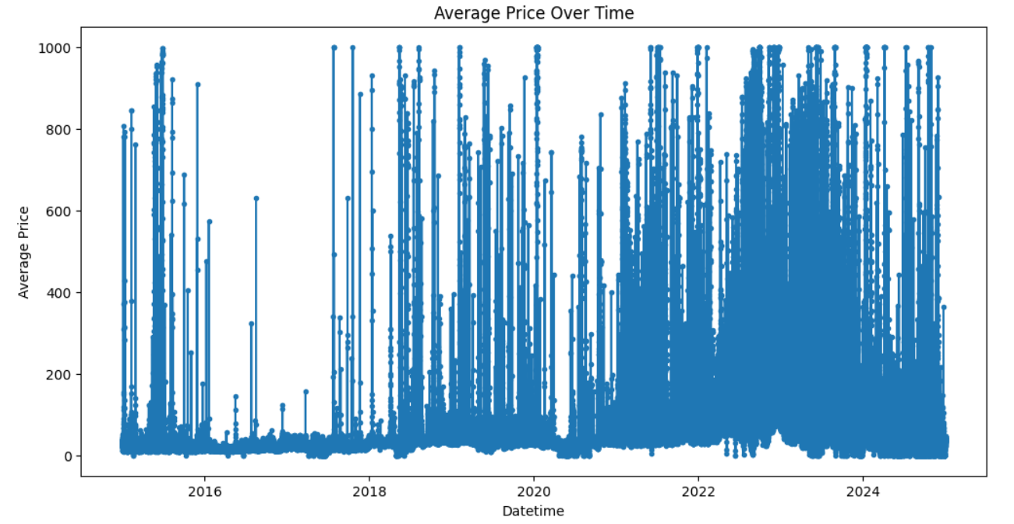
Trends in pricing
What’s causing the prices to reach $999/MW?
It turns out that energy providers tend to estimate the price as $999 when they are unable to ‘predict’ what the spot prices will be for the next hour
We could re-plot this graph to exclude these extreme values such as 0 or 999 and examine what causes the trends

Slide 4
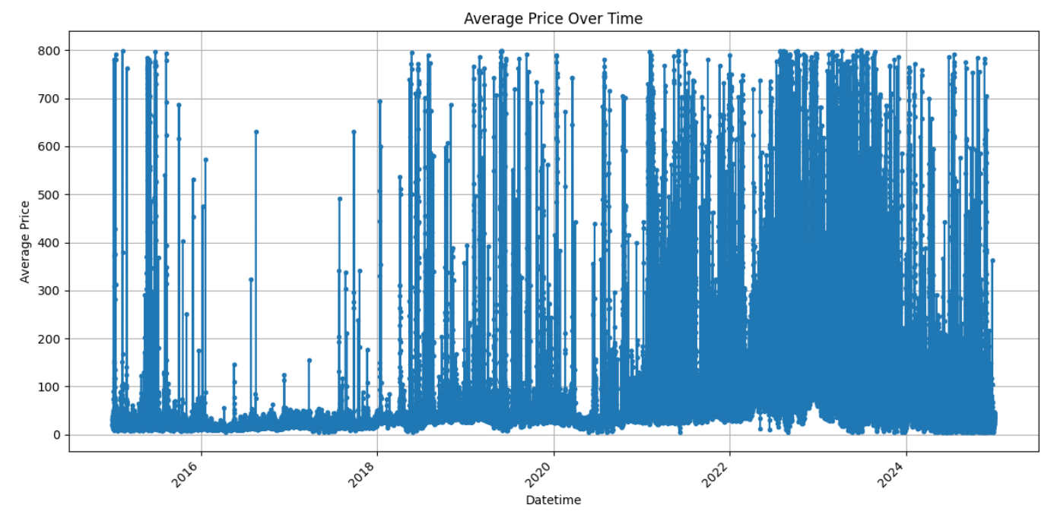
Trends in pricing
Excluding the extreme similar we can see that the graph looks similar
Without the values 0 and 999 we can include the other datasets and check if they had an impact on this trend

Slide 5
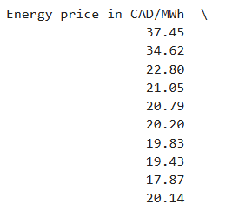
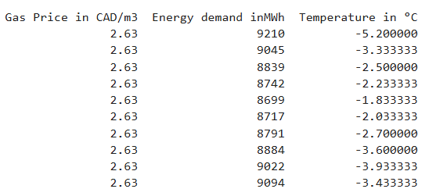
Trends in pricing
Query from the master table, which is a join of all the tables and ordering by energy price in descending order we get the following results
The Gas Price is average, the temperature is not the lowest, but the demand is the highest when it comes to the price

Slide 6
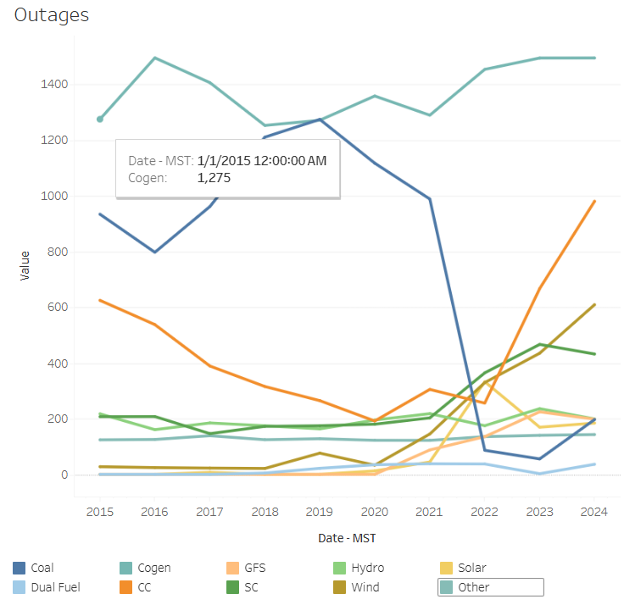
Trends in Pricing
Could outages also be the cause for the rise in the price?
The date for the previous table was for January 01, 2015
However the outages data obtained from AESO's Annual Market Statistics Report
There was no grid outages for that date that could have caused an upward trend in the price
Alberta’s website includes the following for an outage to occur: high winds, freezing rain, flooding, extreme heat and cold

